Slide 1
Redistribution and Equilibrium Work
Chicago Price Theory

Slide 2
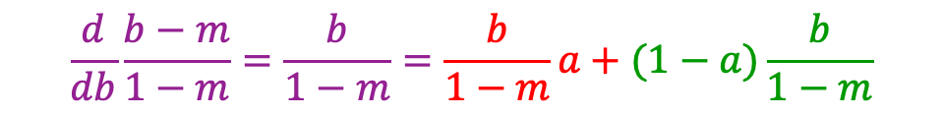
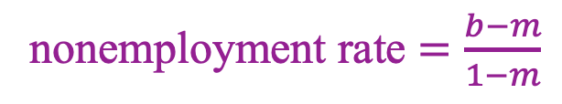
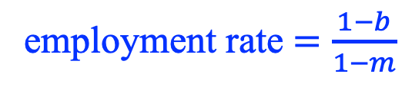
Seasonal/cyclical employment
Surplus from work
1
Separation
Hire
Separation
Hire
b
m
employment rate $=\frac{1−b}{1−m}$
nonemployment rate $=\frac{b−m}{1−m}$
$$\frac{d}{db}\frac{b−m}{1−m}=\frac{b}{1−m}=\frac{b}{1−m}a+(1−a)\frac{b}{1−m}$$
Time
0
a
1
1+a

Slide 3
Seasonal/cyclical employment
Surplus from work
Separation
Hire
Separation
1
b
m
$$\frac{d}{db}\frac{b−m}{1−m}=\frac{b}{1−m}=\frac{b}{1−m}a+(1−a)\frac{b}{1−m}$$
Time
0
a
1
1+a

Slide 4
Layoff subsidies, according to “businessmen”
Urban Institute survey of employers
“Some large‐firm interviewees reported that before ARRA. they provided some amount of free or reduced cost Cobra coverage for laid‐off workers….”
“Several of these companies reported that they reduced or dropped this prior benefit in reaction to A.R.R.A.”
--> employers understood that the ARRA subsidized layoffs
[ARRA = American Recovery and Reinvestment Act]
Notes:
4

Slide 5


Slide 6
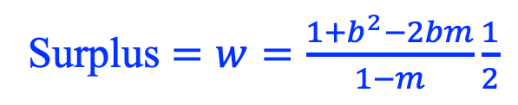
Acyclical employment
Surplus from work
w
bw
Surplus $=w=\frac{1+b^{2}−2bm}{1−m}\frac{1}{2}$
Seasonal surplus is increasing convex in b
Time
0
1

Slide 7
Five substitution margins
Exit unemployment later
Practically all the empirical work is here
Exit employment earlier
Intra-industry factor substitution
i.e., seasonal industry increases labor intensity
Inter-industry output substitution
Seasonal industry grows while aseasonal industry shrinks
Reduced frictions/increased takeup
Incentive to acquire information about the benefit system
Reduced stigma

Slide 8
Budget Sets with Employment- and Income-tested Programs
disposable income
A
UI eligible
C
earnings during time interval
poverty threshold

Slide 10
Includes implicit taxes,
esp. employment taxes

Slide 12

Fallacy of the Heap

Slide 13
Marriage taxes
disposable income
A
earnings during time interval
Married POV

Slide 14
Marriage taxes
disposable income
A
Both HHs below POV
One HH below POV
Both HHs above POV
earnings during time interval
Primary earner POV
Secondary earner POV

Slide 15


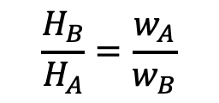
Chicago Price Theory, Figure I-5
“Nonmarket activity”
“Carpenter”
$$H_{B}$$
$$\frac{H_{B}}{H_{A}}=\frac{w_{A}}{w_{B}}$$
Pick B
Pick A
$$H_{A}$$
“Market work”
“Plumber”

Slide 16


Figure I-6: The opportunity set for selecting human capital
$$H_{B}$$
$$H_{A}$$

Slide 17

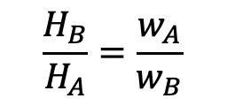

Figure I-7: Specialization Short-run supply is less elastic than long run
What looks like a “wage” is often an income (quantity*price)
“Nonmarket activity”
$$H_{B}$$
$$\frac{H_{B}}{H_{A}}=\frac{w_{A}}{w_{B}}$$
Pick B
Pick A
$$H_{A}$$
“Market work”

Slide 18

“If people are withdrawing their labor, wages should rise; but in the late part of the twentieth century and into the twenty-first, wages fell along with employment, a clear indication that the problem lies with falling demand, not falling supply.”
p. 70

Slide 19
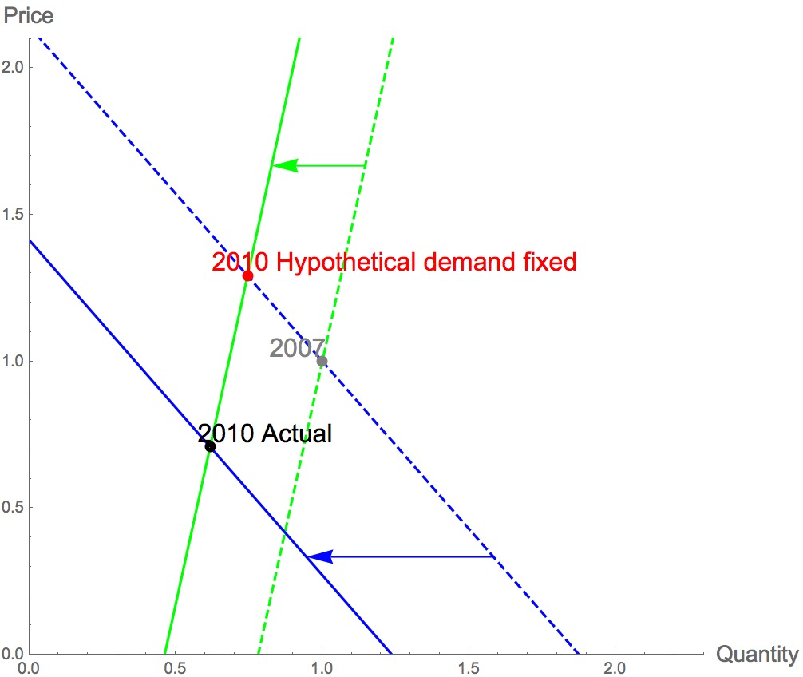

Slide 23
The Residual Method
One of the “Seven Pillars of Statistical Wisdom”
Stephen M. Stigler
John Stewart Mill
“Of all the methods of investigating laws of nature, [the ‘Method of Residues’] is the most fertile in unexpected results; often informing us of sequences in which neither the cause nor the effect were sufficiently conspicuous to attract of themselves the attention of observers.”
Stigler
“today, the residual method is more useful than ever because we are “confronting the questions for which we, after all these centuries, remain least able to provide broad answers.”

